Slide 1





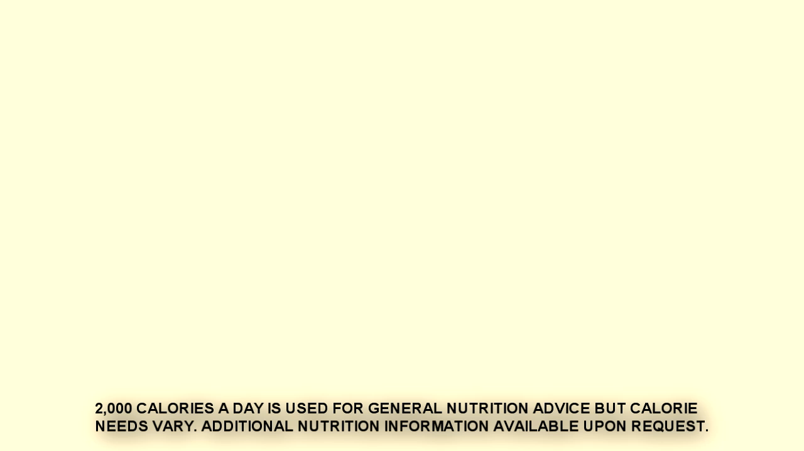
BEVERAGES
 | SMALL | Regular
COCACOLA DRINKS 0-380 Cal
LEMONADE 165 Cal
BOTTLED WATER 0 Cal
BOTTLED DRINK 10-230 Cal
1.69
1.99
2.49
1.49
2.29
Chicken Teriyaki
640 Cal
6.69
6.39
SERVED WITH: • Mixed Vegetables • Steamed Rice
Extra Chicken
(4 oz.) 170Cal
1.69

Slide 2
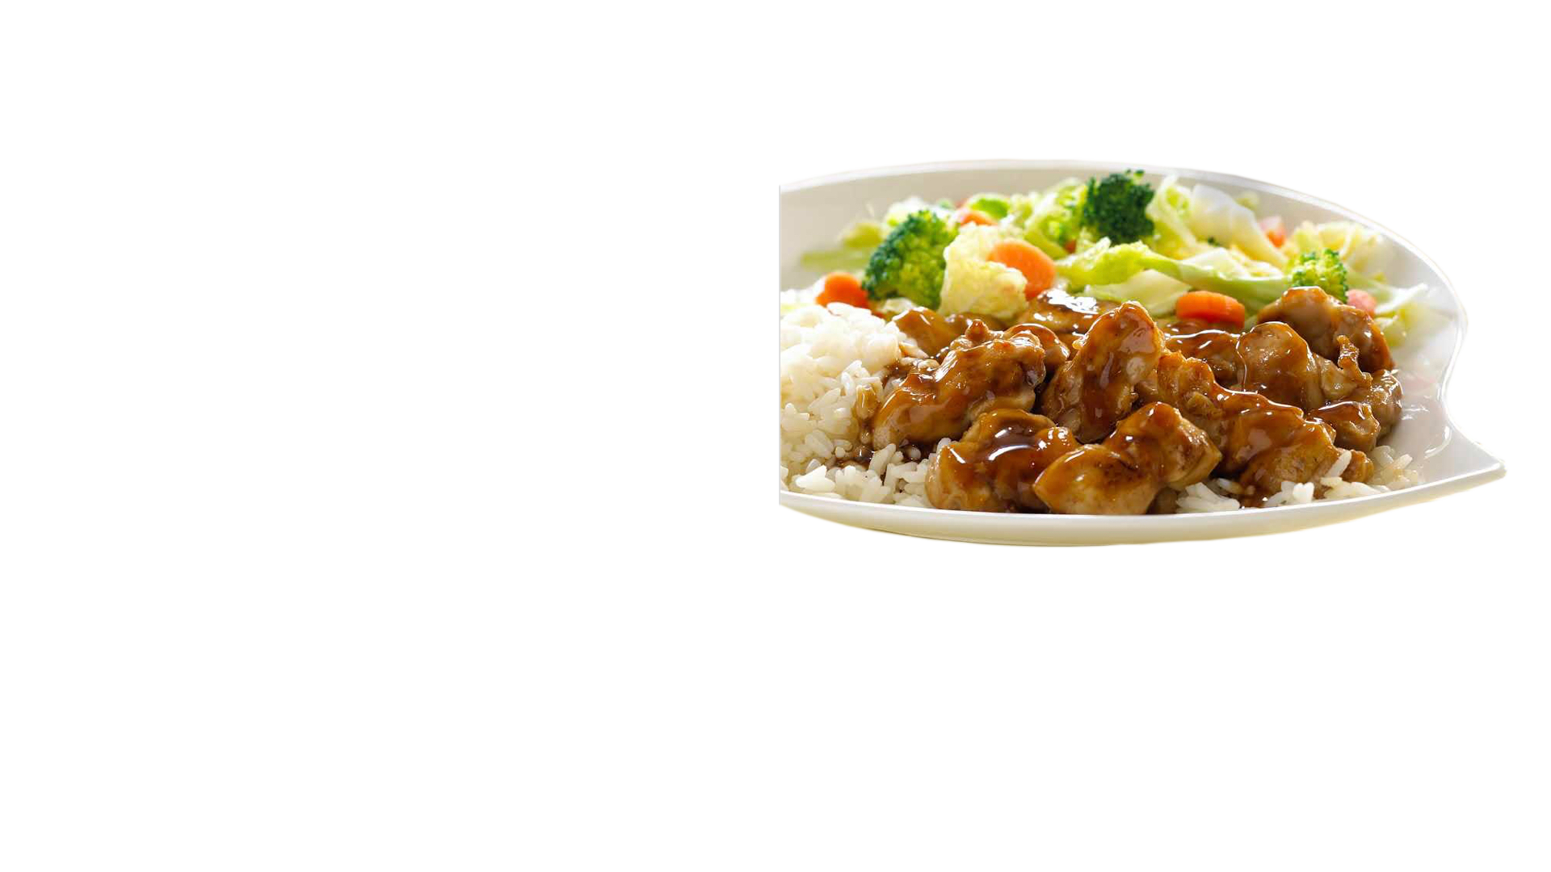
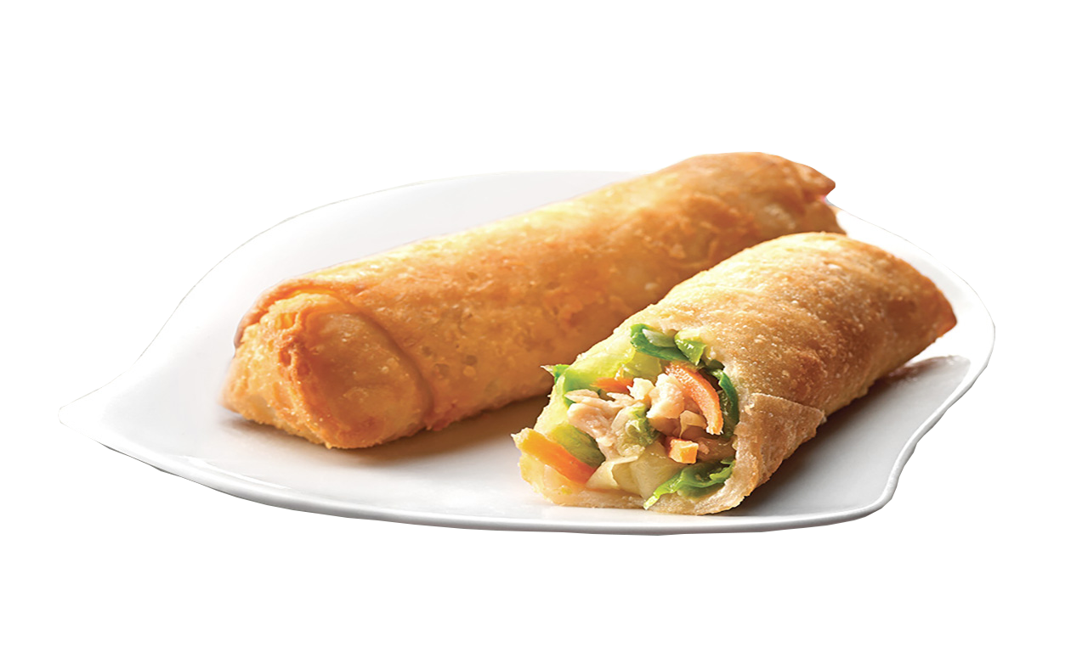
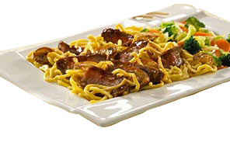
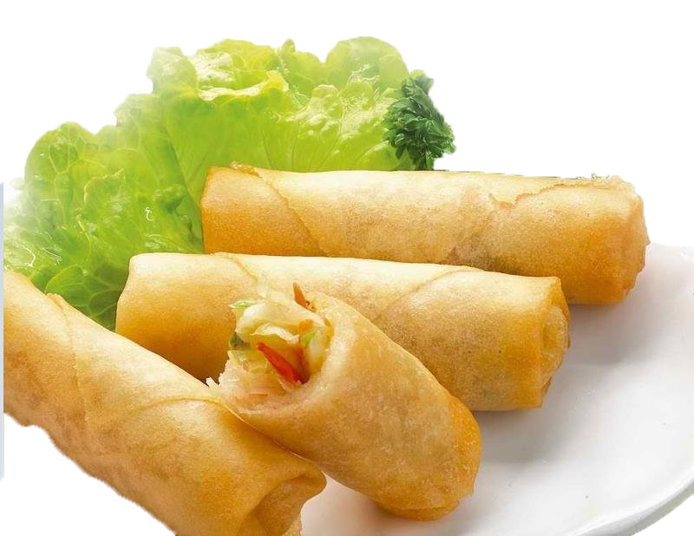
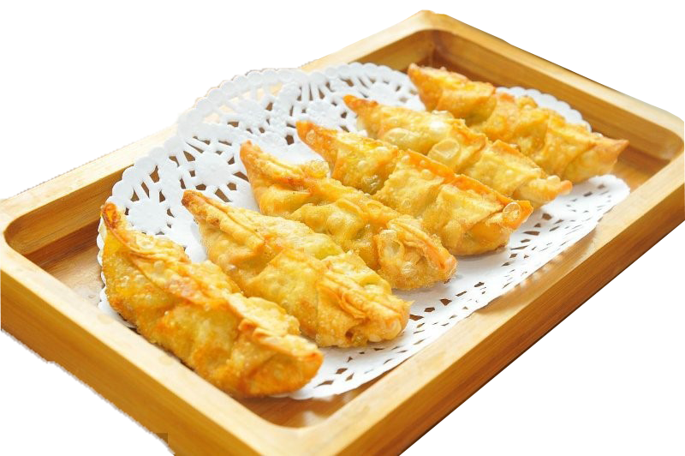
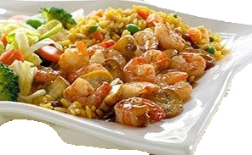
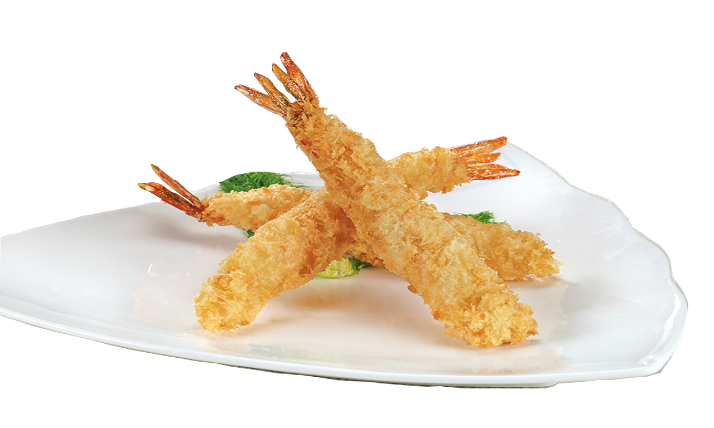
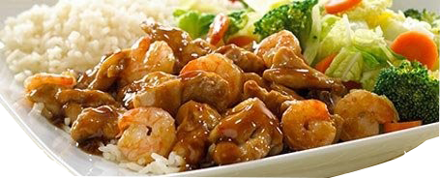
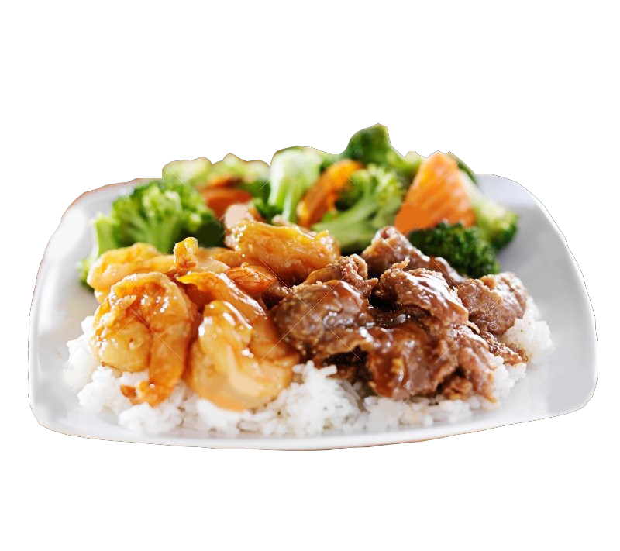

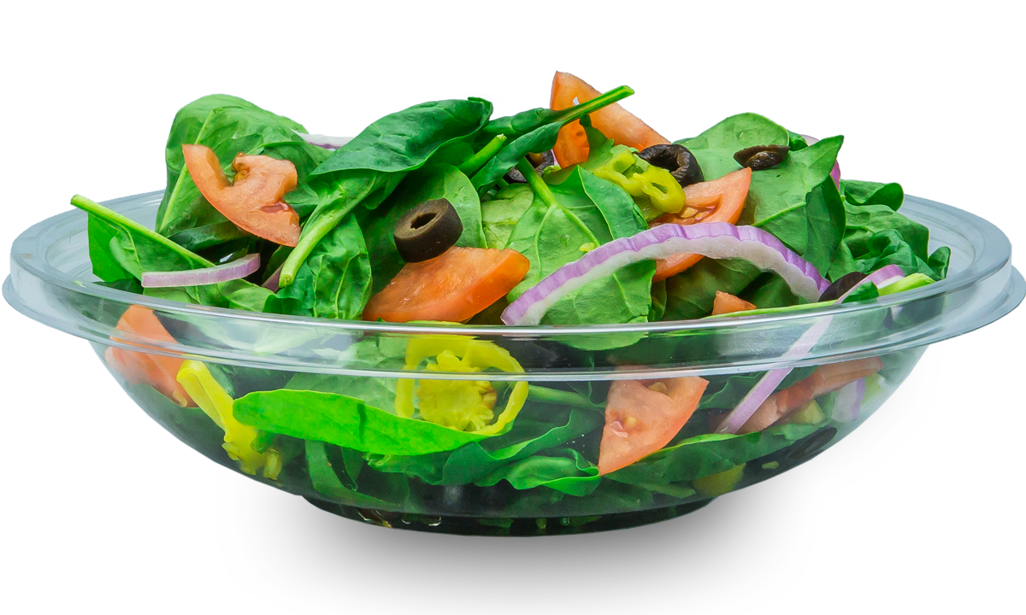

TERIYAKI
SIDE ORDERS
SERVED WITH: • Mixed Vegetables • Steamed Rice
SPRING ROLL (1 PC)
CHICKEN EGG ROLL (1 PC)
1
CHICKEN
2
BEEF
6.99
7.19
0.99
1.29
3
SHRIMP
4
CHICKEN DUMPLINGS (6 PCS)
SHRIMP TEMPURA (3 PCS)
CHICKEN & SHRIMP
7.49
8.19
2.49
2.99
BEEF & SHRIMP
SUBSTITITE STEAMED RICE
D’LITE MEAL
VEGETABLE D’LITE
470 Cal
5
FRIED
Add 20 Cal
0.5
3.49
VEGETABLE SOBA
640 Cal
NOODLES
Add 230 Cal
0.5
3.99
8.29

Slide 3
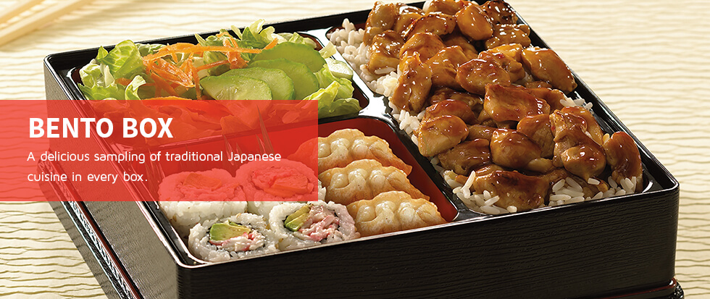
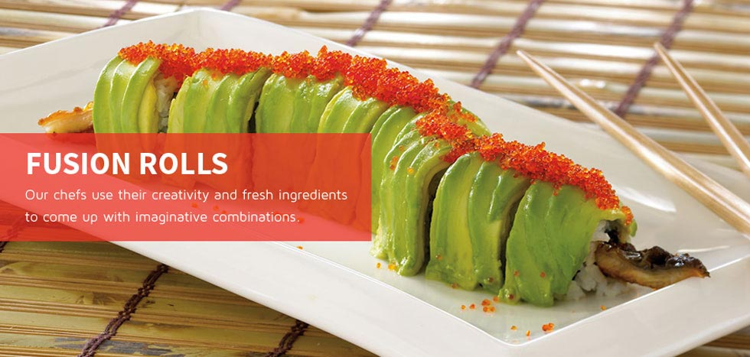
BENTO BOX
REGULAR ROLLS
Chicken Bento | 930 Cal | 8.19
Beef Bento | 810 Cal | 8.99
Shrimp Bento | 750 Cal | 9.49
California Roll | 300 Cal | 4.59
Chicken Teriyaki Roll | 240 Cal | 4.29
Spicy Tuna Roll | 300 Cal | 4.89
Shrimp Tempura Roll | 420 Cal | 5.49
Salmon Avocado Roll | 270 Cal | 5.09
Salmon Roll | 220 Cal | 4.59
Tuna Roll | 190 Cal | 4.59
SERVED WITH:
• Steamed Rice • California Roll (4pcs)
• Dumplings (3pcs) • Garden Salad
FUSION ROLLS
Green Dragon Roll | 560 Cal | 8.49
Volcano Roll | 510 Cal | 8.49
Rock and Roll | 335 Cal | 8.49
Red Bull Roll | 484 Cal | 8.49
Rainbow Roll | 360 Cal | 8.49
ADD-ONS FOR YOUR BENTO BOX
• Shrimp Tempura (1 pc) 130 Cal 1.39
• Extra Chicken (4 oz.) 170 Cal 1.69
• Extra Shrimp (2 oz.) 110 Cal 1.99

